Slide 2
KIGALI, RWANDA 22 – 23 SEPTEMBER 2022

Slide 3
The BCH 3 project and its virtual learning environment

Slide 4
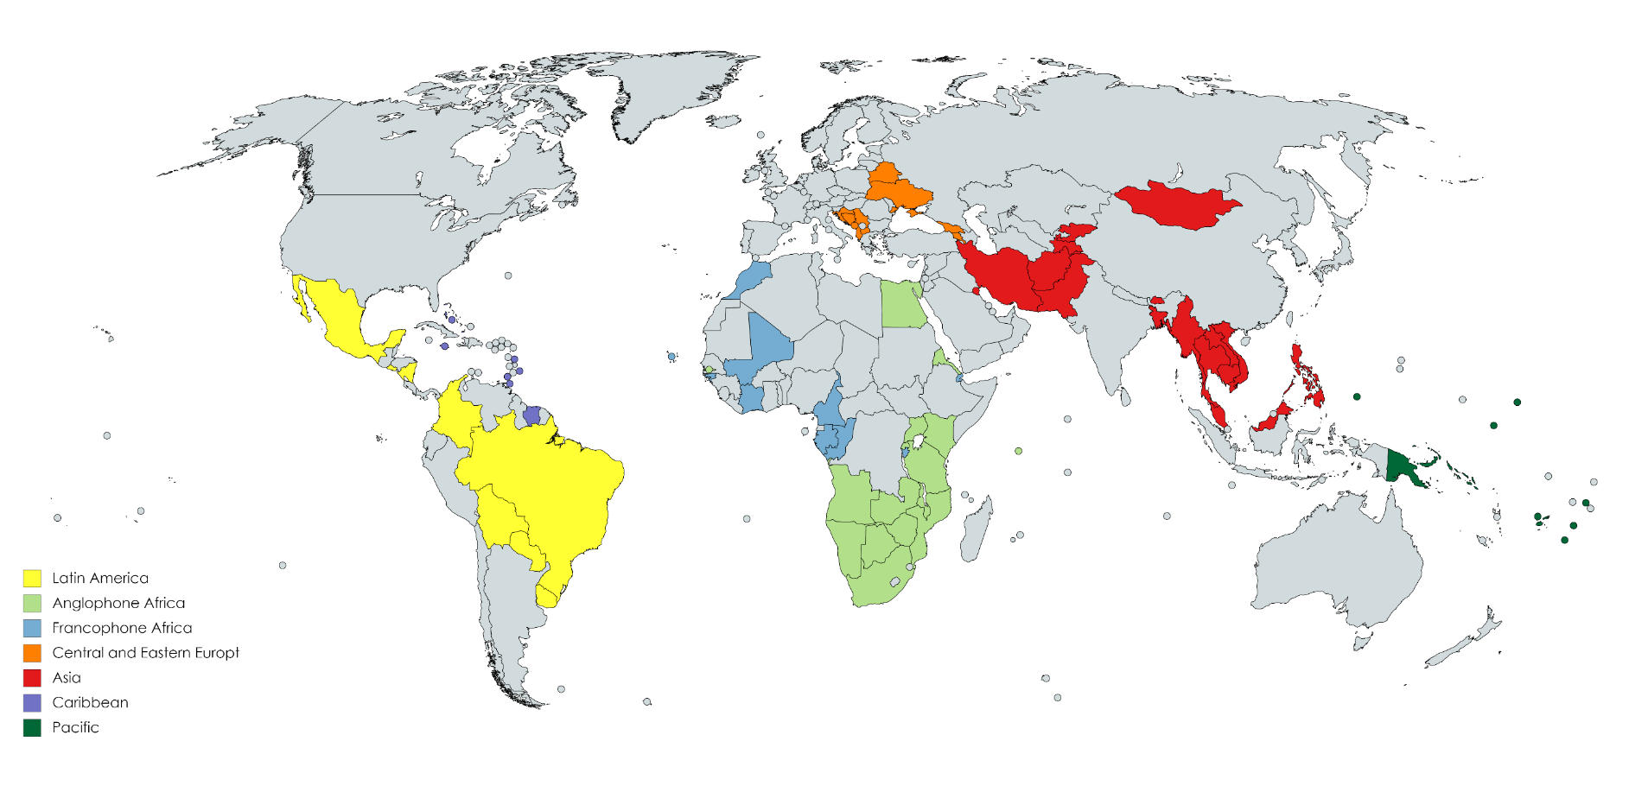
The BCH III project
UN Environment – GEF joint venture;
Project for Sustainable Capacity Building for Effective Participation in the Biosafety Clearing House (BCH phase III);
Global project with 76 participating countries.

Slide 5
Project objective
Overall objective:
To provide support to eligible parties in :
Strengthening of national capacities to effectively access and use the BCH,
Promoting regional and sub-regional collaboration, networking and exchange of experience for national and regional BCH management.

Slide 6
Project components
 | Component 1: Global and Sub-Regional Networking and Knowledge Sharing of Information for effective Management of the BCH;
 | Component 2: Production of BCH educational packages in all UN languages and provision of virtual education tools targeting different stakeholders in national sectors;
 | Component 3: Strengthening and sustainability of the BCH Regional Advisor System as a support to Parties for an effective participation to the BCH;
 | Component 4: Assisting government officials, decision makers and key stakeholders to enhance their understanding and appreciation of what should be placed in the BCH;
 | Component 5: Sustainability and awareness of the BCH and national databases in coordination with UN Agencies and other information sharing initiatives on Biosafety.

Slide 7
Support to countries on the national level
Support received by Countries:
Regional Advisors’ Assistance
Training and Education materials including webinars
National, regional and global training workshops;
Support to integrate national and regional networks of collaboration; and
Virtual Learning Platform (VLE)
http://bch3-vle.unep.org/

Slide 8
Virtual learning environment
Is tool to make all the BCH learning objects accessible to different target audiences.
It includes a variety of pre-developed training material such as manuals, interactive training software, case studies and curricula for different stakeholders.
Training materials are organized as virtual courses over which customized national and regional training solutions can be built.
bch3-vle.unep.org/

Slide 9
Platform to plan, implement, assess and preserve learning activities
Established in 2018, repository , continued to support the project’s learning activities.
Runs on Moodle an open source, new features developed consistently by the community, customizable.
Hosted on UNEP’s cloud servers.

Slide 11
The vle’s essence
Physical, online, hybrid workshops
Maximizing the VLE leads to a successful workshop
The BCH III VLE:
Better coordination
Ubiquitous learning
Eco-friendly
Simpler coursework preparation process
Sustainable storage of the workshops’ materials

Slide 12
Who can access the system?
Roles
Workshop Facilitators – Regional Advisors
Learners – Workshop Participants
Guests (unauthenticated)
Administrators - UNEP

Slide 13
HOW can WE access the system?
Points of entry
Main URL
Search engine e.g. Google, Bing

Slide 14
Guests’ functionalities
Consumption of materials from 4 main categories:
Public BCH training materials
New BCH platform training videos
BCH Animated Videos
A few open national courses e.g. Mozambique
Plan to make most of the materials publicly accessible

Slide 15
Key functionalities
Registration and password resetting – All
Course creation – admins
Course Editing and content creation – Facilitators
Enrollment – All registered users
Knowledge checks – Participants, Facilitators
Feedback collection– Participants, Facilitators
Activity reports and logs– Facilitators, admins

Slide 16
VLE ADMIN BACKEND
Ensure the platform is running smoothly
Ensure up to date, customize, bug fixes, language packs
Content management – course shells, categories, file formats
Integration with other systems
Ensure security – Data protection, backups
Period analytics for reporting
Support to users

