Slide 1
Maputo, mozambique 5 – 6 June 2022

Slide 2
Introduction to the bch

Slide 3
overview
- What is the Biosafety Clearing House (BCH)?
- How does it work?
- Obligations and benefits of the BCH
- What information can be found there?
- In which form is information registered on the BCH?

Slide 4
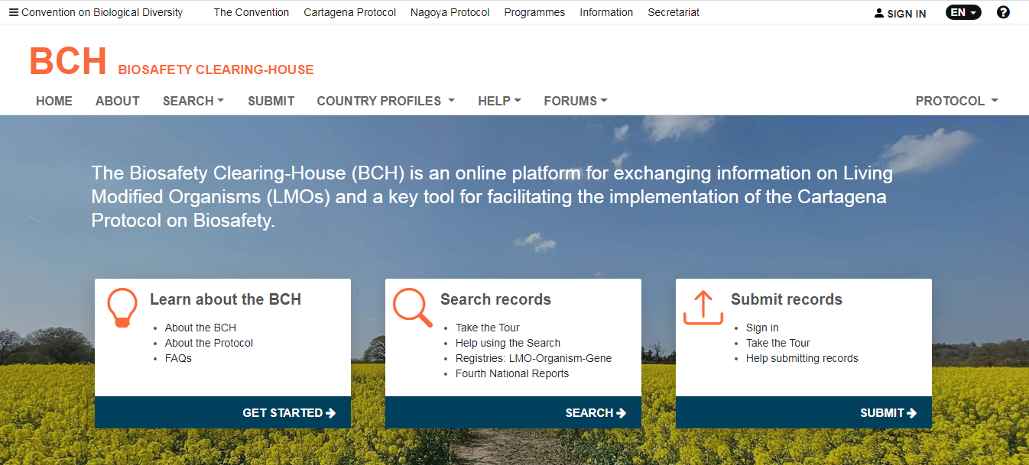
What is The biosafety clearing house (BCH)?
Is a mechanism established in accordance with Article 20 of the Cartagena Protocol in order to:
Facilitate the exchange of scientific, technical, environmental and legal information on, and experience with, living modified organisms; and
Assist Parties to implement the Protocol…

Slide 5
How does it work? (1/2)
Who can access the BCH?
Information in the Biosafety Clearing-House is open and accessible to all users.
You don’t need to be registered to the BCH website to search for information !!
Confidential information should NOT be posted on the BCH.
Who can put information on the BCH?
Different government departments or agencies can put National and Reference Information
General Users and Non-Governmental Organization can put Reference information

Slide 6
How does it work? (2/2)
Language requirements of the BCH?
- The governing body of the Protocol has decided that Information should be submitted to the BCH in a UN official language (Arabic, Chinese, English, French, Russian or Spanish).
- However, full information sources and comments that are linked to records in the BCH may be made available by the submitting government in their original language.
- COP/MOP-1 encourages use of commonly used international languages

Slide 7
Why do we register information on the BCH? (1/3)
- In accordance with Article 20(3) of the Cartagena Protocol, each Party should make available to the BCH certain categories of information = Obligation. These include:
Any existing laws, regulations and guidelines for implementation of the Protocol, as well as information required by the Parties for the advance informed agreement procedure;
Any bilateral, regional and multilateral agreements and arrangements;
Summaries of its risk assessments or environmental reviews of LMOs generated by its regulatory process, including, where appropriate, relevant information regarding products thereof;
Its final decisions regarding the importation or release of LMOs; and
Reports submitted by it pursuant to Article 33, including those on implementation of the advance informed agreement procedure.
- Illegal tranboundary movements (Article 25)
- Unintentional tranboundary movement including a contact point for emergency measures (Article 17)
Notes:
Each Party should, no later than the date of entry into force of this Protocol for it:
designate one National Focal Point (NFP) to be responsible on its behalf for liaison with the Protocol Secretariat (CPB-NFP).
designate one National Focal Point for the Biosafety Clearing-House (BCH-NFP) to liaise with the Secretariat regarding issues of relevance to the development and implementation of the Biosafety Clearing-House.
provide the BCH with details of its the point of contact for receiving notifications from other Parties of unintentional transboundary movements of LMOs.
notify the Secretariat of the names and addresses of its NFP(s) and CNA(s).

Slide 8
Why do we register information on the BCH? (2/3)
- In addition to the Protocol, COP-MOP adopt decisions regarding operational and technical aspects of the BCH, including additional information that should be made available through the BCH;
- Hence, Parties will have to monitor existing and future decisions !!
- Required information should be posted within defined time-frames, or as soon as feasible

Slide 9
Why do we register information on the BCH? (3/3)
- In addition to the information required to be made available to the BCH to comply with the Protocol and the subsequent decisions of the Conference of the Parties, Parties may wish to provide some information voluntarily, including information on laboratories, activities, academic research and projects related to biosafety.
- Governments that are not Parties to the Protocol, as well as non-governmental organizations, are encouraged to register relevant biosafety information on the BCH website.

Slide 10
What are the benefits of the bch?
Access information about
The national laws, regulations and guidelines of other Parties; and information about the decisions and assessments of other countries relating to specific LMOs;
Capacity-building and other assistance available to support implementation of the Protocol;
Ensure that:
All potential exporters of LMOs to their country, or those who wish to transport LMOs across their territory, are aware of their national regulatory requirements;
Relevant authorities in other countries can quickly find out who to inform in the event of an accidental movement of LMOs into their territory.
Assist Governments to make informed decisions regarding the importation or release of LMOs.

Slide 11
categories of information (1/2)
Required
BCH News
National Records:
National Contacts (for competent national authorities and national focal points) (Art. 19)
Laws & Regulations (Art. 2 and 15.3 ) and bi/multilateral/regional agreement (Art. 14)
Country’s Decisions & other Communications
(Art. 6.1, 10.3, 11, 11.1, 12.1 and 13.1) (Art. 14(4), 17 , 18 and 25.3)
National Reports on implementation (Art 33)
Roster of Experts and report on his assignment. (Expert nominated by a country can be of any nationality)
National and Reference Records
Submissions from Parties, other Governments and biosafety relevant organizations
Risk Assessment (Art. 20.3c)
Transit
Import FFP
Application of DR To specific import
Domestic use FFP
Simplified Procedures
Unintentiinal transboundary movement
Illegal transboundary movement
Importation or release AIA
Review of Decision
Handling, transport, packaging and identification

Slide 12
categories of information (2/2)
Reference Records
LMOs, Genetic elements or Organisms
Capacity-Building (both needs as well as opportunities)
Directory of International Organizations involved in Biosafety Activities
The BCH Virtual Library

Slide 13
In which form is information registered on the bch?
- Information is registered in the form of records having a standardized structure (common format) to be filled with the required information.
- Common formats are intended to facilitate the indexing of information and its inclusion in databases which simplifies searching for and locating information in the BCH databases
- Records common formats are adopted by the Conference of the Parties to the Protocol

Slide 14
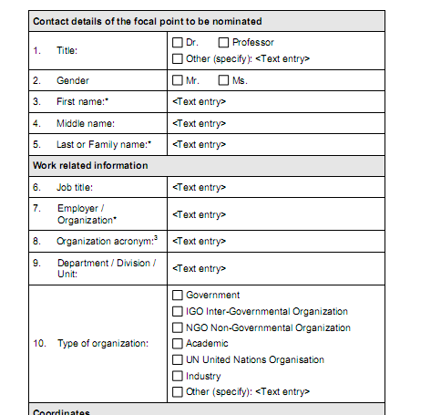
Example of common format
Data entry form

Slide 15
Thank you !

