Slide 1
MAPUTO, MOZAMBIQUE 6 – 7 JUNE 2022

Slide 2
The Cartagena protocol in brief

Slide 3
What is biosafety?
- Biosafety is a term used to describe efforts to minimise and avoid the potential risks resulting from modern biotechnology and its products.

Slide 4
The precautionary approach
The United Nations Conference on Environment and Development in Rio de Janeiro, Brazil, 1992, adopted 27 principles to underpin sustainable development.
Principle 15 (also known as the precautionary principle) states that:
“In order to protect the environment, the precautionary approach shall be widely applied by States according to their capabilities. Where there are threats of serious or irreversible damage, lack of full scientific certainty shall not be used as a reason for postponing cost-effective measures to prevent environmental degradation.”

Slide 5
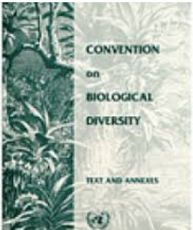
the convention on biological diversity (CBD)
- Is an international treaty that has 3 objectives:
The conservation of biological diversity,
The sustainable use of its components and
The fair and equitable sharing of the benefits arising out of the utilization of genetic resources.
- It entered into force on 1993
- The issue of safety in biotechnology is addressed in articles 8(g) and 19(3) of the CBD.
Notes:
- The convention on Biological diversity (CBD) is an international treaty that has three objectives namely the conservation of biological diversity, the sustainable use of its components and the fair and equitable sharing of the benefits arising out of the utilization of genetic resources.
- It entered into force on 1993.
- States and Regional Economic Integration Organizations that join the convention and agree to be legally bound by its provisions are called “Parties” to the Convention.
- The issue of safety in biotechnology is addressed in articles 8(g) and 19(3) of the CBD.

Slide 6
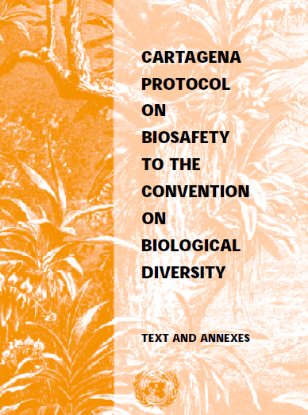
The Cartagena protocol on biosafety (CPB)
- The Conference of the Parties to the CBD adopted the Cartagena Protocol on Biosafety on 29 January 2000 in Montreal, Canada.
- The Cartagena Protocol on Biosafety is an international agreement (treaty), concluded and adopted in the framework of the Convention on Biological Diversity (CBD)
- It entered into force on September 11, 2003
- As of date: 173 Parties
- Governing body: COP - MOP
Notes:
The Conference of the Parties to the CBD adopted the Cartagena Protocol on Biosafety on 29 January 2000 in Montreal, Canada.
The Protocol entered into force on 11 September 2003 upon ratification by the fiftieth Party.
- Having said that, The Cartagena Protocol on Biosafety is an international agreement , concluded and adopted in the framework of the Convention on Biological Diversity

Slide 7
Some definitions
Living Modified Organism (LMO): Any living organism that possesses a novel combination of genetic material obtained through the use of modern biotechnology
Modern biotechnology: means the application of:
In vitro nucleic acid techniques, including recombinant deoxyribonucleic acid (DNA) and direct injection of nucleic acid into cells or organelles,
or Fusion of cells beyond the taxonomic family,
that overcome natural physiological reproductive or recombination barriers and that are not techniques used in traditional breeding and selection;
Notes:
Some definitions
Living Modified Organism (LMO): Any living organism that possesses a novel combination of genetic material obtained through the use of modern biotechnology
Modern biotechnology: means the application of:
In vitro nucleic acid techniques, including recombinant deoxyribonucleic acid (DNA) and direct injection of nucleic acid into cells or organelles,
or Fusion of cells beyond the taxonomic family,
that overcome natural physiological reproductive or recombination barriers and that are not techniques used in traditional breeding and selection;

Slide 8
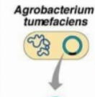
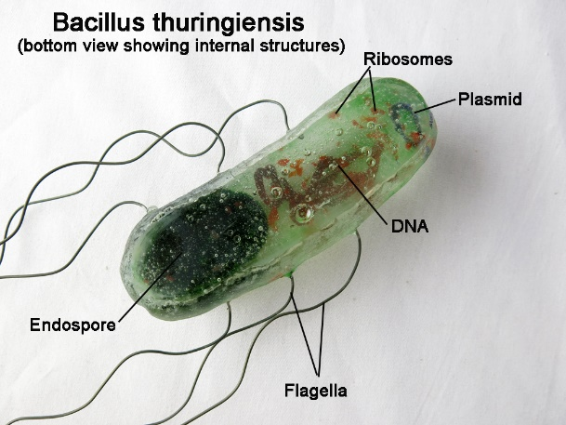
example
Notes:
An example is the genetically modified Cotton line MON531. It was genetically engineered to resist the bollwarms by producing its own insecticide. This line was developed by introducing the cry1Ac gene, isolated from the common soil bacterium Bacillus thuringiensis (Bt), into a cotton line by Agrobacterium-mediated transformation.
The bollgard possesses a novel combination of genetic material and in addition to the normal cotton genes it has genes inserted from a bacteria overcoming the natural physiological reproductive or recombination barriers

Slide 9
Objective of the Cartagena protocol (Art.1)
Art. 1
- […] the objective of this Protocol is to contribute to ensuring an adequate level of protection in the field of the safe transfer, handling and use of living modified organisms resulting from modern biotechnology that may have adverse effects on the conservation and sustainable use of biological diversity, taking also into account risks to human health, and specifically focusing on transboundary movements.
- The phrase “may have adverse effects” indicates adherence to the precautionary approach: protection is called for not only if the adverse effects are a certainty, and have been established as such by full scientific evidence, but also if there is a threat of adverse effects.
Notes:
The objective of the protocol is stated in its article 1, it says “In accordance with the precautionary approach contained in Principle 15 of the Rio Declaration on Environment and Development, the objective of this Protocol is to contribute to ensuring an adequate level of protection in the field of the safe transfer, handling and use of living modified organisms resulting from modern biotechnology that may have adverse effects on the conservation and sustainable use of biological diversity, taking also into account risks to human health, and specifically focusing on transboundary movements. “
The phrase “may have adverse effects” indicates adherence to the precautionary approach: protection is called for not only if the adverse effects are a certainty, and have been established as such by full scientific evidence, but also if there is a threat of adverse effects.

Slide 10
General provisions
Art. 2
- Each Party shall take necessary and appropriate legal, administrative and other measures to implement its obligations under this Protocol.
- […] the right of a Party to take action that is more protective of the conservation and sustainable use of biological diversity than that called for in this Protocol, provided that such action is consistent with the objective and the provisions of this Protocol and is in accordance with that Party's other obligations under international law.

Slide 11
Scope of the protocol
Art. 4
“This Protocol shall apply to transboundary movement, transit, handling and use of all living modified organisms that may have adverse effects on the conservation and sustainable use of biological diversity, taking also into account risks to human health.”
[…] without prejudice to any right of a Party to subject all living modified organisms to risk assessment prior to the making of decisions on import, this Protocol shall not apply to the transboundary movement of living modified organisms which are pharmaceuticals for humans that are addressed by other relevant international agreements or organizations
Art. 5
Notes:
The scope of the protocol as stated in its article 4 is the transboundary movement, transit, handling and use of all living modified organisms that may have adverse effects on the conservation and sustainable use of biological diversity, taking also into account risks to human health.
Article 5 indicates that Pharmaceuticals that are LMOs for human to be excluded from the scope of the protocol they need to be addressed by other relevant international agreements or organizations. So far this did not happen and this exclusion remains as an open door that has not been crossed

Slide 12
Application of the CPB
Categories of LMOs
Procedures
[Art. 7-10]
1. LMOs for intentional introduction into the environment (eg. Seed for planting;
2. LMOs for direct use as a food or feed, or processing (e.g. Corn for human consumption);
3. LMOs destined for contained use in the Party of import (GMO for laboratory use, R&D);
4. LMOs in transit
1. Advanced informed Agreement procedure.
2. Procedure for LMOs Intended for Direct Use as Food or Feed, Or For Processing.
No specified Procedure / just highlight some rights and obligations of a party
[Art. 11]
[Art. 6]
3. Simplified Procedure [Art. 13].
Notes:
The protocol classifies LMOs into the follwoing categories:
LMOs for intentional introduction into the environment [Art. 7-10]
LMOs for direct use as a food or feed, or processing. [Art. 11].
LMOs in transit [Art. 6];
LMOs destined for contained use [Art. 6] in the Party of import;
However the protocol specifies procedures that are applicable to the transboundary movement of only some of those categories of LMOs.
Procedures include the following:
The advance informed agreement procedure applies prior to the first intentional transboundary movement of living modified organisms destined for intentional introduction into the environment of the Party of import.
- Procedure for LMOs that are destined for direct use as food, feed or for processing. they are not intended to be introduced into the environment such as bulk grains export and may be subject to transboundary movement
- For LMOs in transit and those destined for contained use, the protocol does not specify a given procedure and leave it to be regulated on the national level. The protocol just highlight the right of a Party of transit to regulate the transport of living modified organisms through its territory and the right of a Party to subject all living modified organisms to risk assessment prior to decisions on import and to set standards for contained use within its jurisdiction

Slide 13
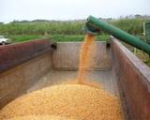
AIA Procedure
1
Notification
Informations
Annex I
Notifier
Party of import
2
Acknowledge reception
90 days
3
Decision
Introduction into the environment
270 days
BCH
approving the import (with or without conditions)
prohibiting the import,
requesting additional relevant information
Informing the notifier that the period is extended
Risk Assessment.
Socioeconomic Considerations
Precaution Approach
Public Participation (Art. 23) and confidential information (Art. 21)
Notes:
The advance informed agreement procedure in Articles 8 to 10 and 12 applies prior to the first intentional transboundary movement of living modified organisms destined for intentional introduction into the environment of the Party of import.
Now going to the details:
The Party of export should notify, or require the exporter to ensure notification to, in writing, the competent national authority of the Party of import prior to the intentional transboundary movement of the living modified organism intended to be introduced into the environment. ( concerning the notification it should contain at a minimum, the information specified in Annex I of the protocol and The Party of export should ensure that there is a legal requirement for the accuracy of information provided by the exporter.)
The Party of import then acknowledges receipt of the notification, in writing, to the notifier within ninety days of its receipt. (The acknowledgement should include a) The date of receipt of the notification; b) Whether the notification, prima facie, contains the required information; c) Whether to proceed according to the domestic regulatory framework of the Party of import or according to the procedure specified in Article 10.)
Within two hundred and seventy days of the date of receipt of notification, the Party of import communicates, in writing, to the notifier and to the Biosafety Clearing-House the decision ( decision can be: a) Approving the import, with or without conditions, including how the decision will apply to subsequent imports of the same living modified organism; b) Prohibiting the import; c) Requesting additional relevant information in accordance with its domestic regulatory framework or Annex I; or d) Informing the notifier that the period specified in this paragraph is extended by a defined period of time.
In calculating the time within which the Party of import is to respond, the number of days it has to wait for additional relevant information is not to be taken into account.

Slide 14
Procedure for LMO intended for direct use as food or feed, or for processing (ffp)
Bulk grains export
Art. 11
Final decision regarding domestic use, including placing on the market, of a LMO that may be subject to transboundary movement for direct use as FFP should, within 15 days of making that decision, inform the Parties through the BCH. This information shall contain, at a minimum, the information specified in Annex II.
In the absence of the domestic regulatory framework parties may declare through the BCH that its decision prior to the first import of a LMO for FFP, will be taken according to the following:
A risk assessment undertaken in accordance with Annex III; and
A decision made within a predictable timeframe, not exceeding 270 days.
Notes:
The procedure specified by the protocol for the living modified organisms intended for direct use as food or feed or for processing is as follows:
A Party that makes a final decision regarding domestic use, including placing on the market, of a living modified organism that may be subject to transboundary movement for direct use as food or feed, or for processing should, within fifteen days of making that decision, inform the Parties through the Biosafety Clearing-House.
This information should contain, at a minimum, the information specified in Annex II.
This provision is not applied to decisions regarding field trials.

Slide 15
What is the main difference between AIA and FFP procedures ?
AIA procedure = bilateral procedure, which is based on direct communication between Parties
LMO-FFPs procedure = essentially a multilateral information exchange mechanism, centered on the BCH
BCH
BCH

Slide 16
Review of decisions
Art. 12
A Party of import may, at any time, in light of new scientific information, review and change a decision… but should inform the notifier and the BCH within 30 days of the decision and its reasons.
A Party of export or a notifier may also request the Party of import to review its decisions if there is a change in circumstances influencing the outcome of risk assessment or new technical information becomes available.
Notes:
According to article 12 of the protocol
- Party of import may, at any time, in light of new scientific information on potential adverse effects on the conservation and sustainable use of biological diversity, taking also into account the risks to human health, review and change a decision regarding an intentional transboundary movement. In such case, the Party should, within thirty days, inform the notifier, as well as the Biosafety Clearing-House, and shall set out the reasons for its decision.
- A Party of export or a notifier may request the Party of import to review a decision it has made in respect of it under Article 10 when :(a)
A change in circumstances has occurred that may influence the outcome of the risk assessment upon which the decision was based; or
(b) Additional relevant scientific or technical information has become available. In such case, the Party of import should respond in writing to such a request within ninety days and set out the reasons for its decision.

Slide 17
Transit and contained use
Art. 6
Two limited and qualified exceptions from the general scoop of applicability of the Protocol. These apply to:
LMOs in transit through the territory of a Party; and
LMO destined for contained use in the importing Party
The Party have a right to regulate the entry of such LMOs into their territory
Notes:
The simplified procedure: In Accordance with Article 13, a Party may decide to subject specific LMO to simplified procedures provided that adequate measures are applied to ensure safe intentional transboundary movement of LMOs in accordance with the Protocol’s objectives. Where it opts to do this, a Party must specify in advance to the BCH cases in which import of an LMO to it may take place at the same time as the transboundary movement is notified to it, and imports of LMOs to it that it has decided to exempt from the AIA procedure.

Slide 18
Simplified procedure
Art. 13
Protocol leaves to Parties of import the discretion in how they address potential import of LMOs for intentional introduction into environment
Parties specify in advance to the BCH cases in which import of an LMO :
Cases where TB movement occurs at same time as importing Party is notified
LMO imports exempted from AIA
Information should contain, at a minimum, the information specified in Annex I
Provided that adequate measures are applied to ensure safe intentional transboundary movement of LMOs in accordance with the Protocol’s objectives.
Notes:
The simplified procedure: In Accordance with Article 13, a Party may decide to subject specific LMO to simplified procedures provided that adequate measures are applied to ensure safe intentional transboundary movement of LMOs in accordance with the Protocol’s objectives. Where it opts to do this, a Party must specify in advance to the BCH cases in which import of an LMO to it may take place at the same time as the transboundary movement is notified to it, and imports of LMOs to it that it has decided to exempt from the AIA procedure.

Slide 19
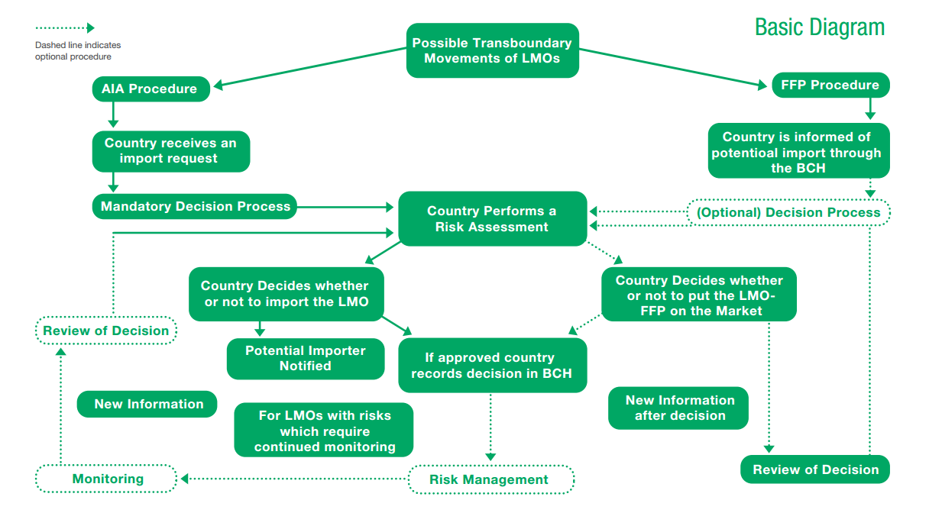

Slide 20
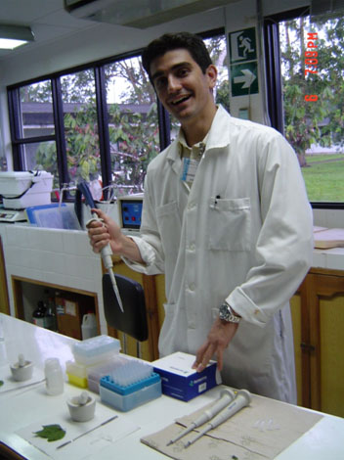
Risk assessment (ra)
Art. 15
RA should be carried out in a scientifically sound manner and in accordance with Annex III of the protocol
The right of a party to subject all living modified organisms to risk assessment prior to the making of decisions on import
The cost of risk assessment shall be borne by the notifier if the Party of import so requires.
Notes:
Risk assessments undertaken pursuant to this Protocol should be carried out in a scientifically sound manner, in accordance with Annex III and taking into account recognized risk assessment techniques.
The cost of risk assessment shall be borne by the notifier if the Party of import so requires.
The Party of import should ensure that risk assessments are carried out for decisions taken under Article 10.
And in this regards, it is important to highlight the right of a party to subject all living modified organisms to risk assessment prior to the making of decisions on import

Slide 21
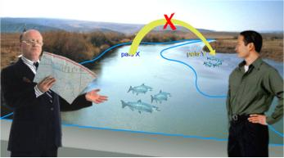
Unintentional Transboundary Movements
Article 17
*LMO
NOTIFICATION
-Quantities
-Characteristics
-Date of the release
-Circumstances
-Possible risks
Party that releases the LMO
Potentially affected States and the BCH
*CONSULT
Determine appropiate responses, including emergency measures
Establish agreed solutions
Develop joint plans of action
Notes:
Script:
Now going to Article 17 of the protocol on unintentional transboundary movement and emergency measures
- Party should take appropriate measures to notify affected or potentially affected States, the Biosafety Clearing-House and, where appropriate, relevant international organizations, when it knows of an occurrence under its jurisdiction resulting in a release that leads, or may lead, to an unintentional transboundary movement of a living modified organism that is likely to have significant adverse effects on the conservation and sustainable use of biological diversity, taking also into account risks to human health in such States. The notification shall be provided as soon as the Party knows of the above situation.
- A notification should include: a) Available relevant information on the estimated quantities and relevant characteristics and/or traits of the living modified organism; b) Information on the circumstances and estimated date of the release, and on the use of the living modified organism in the originating Party; c) Any available information about the possible adverse effects on the conservation and sustainable use of biological diversity, taking also into account risks to human health, as well as available information about possible risk management measures; d) Any other relevant information; and e) A point of contact for further information.
- In order to minimize any significant adverse effects each Party, under whose jurisdiction the release of the living modified organism occurs, shall immediately consult the affected or potentially affected States to enable them to determine appropriate responses and initiate necessary action, including emergency measures.

Slide 22
Illegal transboundary movements
Art. 25
Parties need to adopt appropriate domestic measure aiming at preventing and penalizing transboundary movements of LMOs carried out in contravention to domestic measures;
Affected party may request the party of Origin to dispose at its own expense the LMO in question;
Parties need to make available to the BCH information concerning illegal transboundary movements pertaining to it.
Notes:
Article 25 illegal tranboundary movements
1. Each Party shall adopt appropriate domestic measures aimed at preventing and, if appropriate, penalizing transboundary movements of living modified organisms carried out in contravention of its domestic measures to implement this Protocol. Such movements shall be deemed illegal transboundary movements.
2. In the case of an illegal transboundary movement, the affected Party may request the Party of origin to dispose, at its own expense, of the living modified organism in question by repatriation or destruction, as appropriate.
3. Each Party shall make available to the Biosafety Clearing-House information concerning cases of illegal transboundary movements pertaining to it.

Slide 23
Confidential information (1/2)
Art. 21
1. Notifier identifies submitted information that is to be treated as confidential;
2. Prior to any disclosure, The Party of import inform the notifier of its decision if the information qualify for such treatment;
3. If the notifier diagree and withdraw the notification, the Party of import respect the confidentiality of commercial and industrial information, including research and development information as well as information on which their confidentiality diasgreement.
4. Confidential information are to be disclosed (not to be published on the BCH) or used for commercial purpose

Slide 24
Confidential information (2/2)
Art. 25 (6)
The following information can not be considered as confidential:
(a) The name and address of the notifier;
(b) A general description of the living modified organism or organisms;
(c) A summary of the risk assessment of the effects on the conservation and sustainable use of biological diversity, taking also into account risks to human health; and
(d) Any methods and plans for emergency response.

Slide 25
Other issues
Handling, Transport, Packaging and Identification
Liability and Redress
Art. 18
Art. 27
Notes:
The issue of Handling, Transport, Packaging and Identification was one of the issues that were not fully finalized in the negotiation of the text of the Cartagena Protocol. Article 18 of the protocol mandated Parties to take necessary measures requiring that living modified organisms that are subject to intentional transboundary movement are handled, packaged and transported under conditions of safety, taking into consideration relevant international rules and standards. However some relevant points such as the need for and modalities of developing standards with regard to identification, handling, packaging and transport practices were left for the conference of the parties to decide on later as clearly stated in Article 18.3
The issue of liability and redress was another one of the topics that needed further elaboration and discussion and was not settled at the time of adoption of the Cartagena Protocol. Article 27 of the protocol mandated the Conference of the Parties serving as the meeting of the Parties to the Protocol to adopt , at its first meeting, a process with respect to the appropriate elaboration of international rules and procedures in the field of liability and redress for damage resulting from transboundary movements of living modified organisms. Several years later, the process led to the The Nagoya – Kuala Lumpur Supplementary Protocol on Liability and Redress to the Cartagena Protocol on Biosafety
-

Slide 26
About the LMOs unique identifier
In accordance with the Protocol, it is expected that the Unique identifier for LMOs intended for direct use as food, feed or for processing (decisions taken under Article 11) to be available, since most of these organisms are expected to be approved for use in trade.
The Third Meeting of the Parties to the Protocol also requested Governments to provide information on the unique identifier, where it exists, when decisions taken under the Advanced informed agreement are registered.

Slide 27
Questions ON CPB definitions and scope
- For a shipment of cloned pigs arriving from abroad do we have to apply the requirements of the Biosafety Protocol?
- A pharmaceutical company wants to ship a genetically modified live vaccine for hepatitis B to its sister company in in another country do we have to apply the requirements of the Biosafety Protocol?

Slide 28
Thank you !

