Slide 1
KIGALI, RWANDA 22 – 23 SEPTEMBER 2022

Slide 2
Type of records on the bch
There are 3 types of records on the BCH
National records
Reference records
SCBD records

Slide 3
National records
National Focal Points
Competent National Authorities
Supplementary Protocol Competent Authorities
Biosafety Laws, Regulations, Guidelines and Agreements
Countries' Decisions or any other Communications
Risk Assessments generated by a regulatory process
National Biosafety Websites or Databases
Fourth National Reports on the Implementation of the Cartagena Protocol on Biosafety
Third National Reports on the Implementation of the Cartagena Protocol on Biosafety
Second National Reports on the Implementation of the Cartagena Protocol on Biosafety
First National Reports on the Implementation of the Cartagena Protocol on Biosafety
Interim National Reports on the Implementation of the Cartagena Protocol on Biosafety
Biosafety Experts
Country Profiles for Biosafety Clearing-House
Contacts

Slide 4
Who can register national records?
BCH National Focal points (NFP); and
National Authorized User (NAU)

Slide 5
What is the role of BCH-nfp?
Liaison with the Secretariat of the Convention on Biological Diversity on the technical aspects of national participation in the BCH, as well as issues of relevance to the development and implementation of the BCH.
Registering and publishing national records to the BCH
Clear, for publishing, information registered on the BCH by NAU, including validation at a national level of records to make them publicly available through the central portal of the BCH.
Facilitate the establishment of a network of multi-sectoral partnerships and participants, as appropriate, in the implementation of the process of registering national information on the BCH.

Slide 6
How to designate a bch-NFP?
The BCH NFP is designated through a written communication addressed to the Executive Secretary of the Convention on Biological Diversity and approved by the country’s relevant authorities these include:
Government of the country
Focal Point of the Convention on Biological Diversity
Focal Point of the Cartagena Protocol on Biosafety
Based on this official communication, the Secretariat registers the BCH –NFP to the BCH and gives him credential to register national information and manage the National Authorized Users (NAUs).

Slide 7
What is a National authorized user (nau)?
User registered in the BCH who, in the context of his country, has the authority to cooperate in registering national records in the BCH;
Work in coordination with the national focal point;
He may enter register national records on in the BCH, but these records will only be published after it has been validated and approved by the BCH-NFP;
A country BCH NFP may designate as many NAU as he wants

Slide 8
Reference records
Biosafety Virtual Library Resources
Biosafety Organizations
Laboratories for detection and identification of LMOs
Living Modified Organisms
Genetic elements
Organisms
Risk Assessments generated by an independent or non-regulatory process
Submissions
Capacity Development Initiatives
BCH News

Slide 9
Who can register reference records?
Any registered user on the BCH and are validated by the Secretariat prior to their publication.
How to register for a General user BCH account ?

Slide 10
SCBD records
News
Notifications
What's New
Meetings
Statements
Press Releases
Meeting Documents

Slide 11
Who can register SCBD records?
Information are only published by the SCBD. This includes meetings, news stories, notifications and statements.

Slide 12
In which form is information registered on the bch?
- Information is registered in the form of records having a standardized structure (common format) to be filled with the required information.
- Common formats are intended to facilitate the indexing of information and its inclusion in databases which simplifies searching for and locating information in the BCH databases
- Records common formats are adopted by the Conference of the Parties to the Protocol

Slide 13
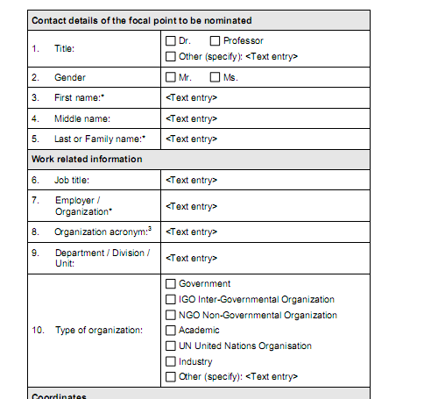
Example of common format
Data entry form

Slide 14
- It is Recommended to download the offline common formats, gather all required information, and then register using the online formats via the Management Centre
- https://bch.cbd.int/resources/common-formats/

Slide 15
How to register for General user BCH account?
Demonstration on the Biosafety Clearing-House website
https://bch.cbd.int/

Slide 16
How to register a record on the bch using the management center?
Exercise: Registering a news record on the BCH management center

Slide 17
How to register records on the bch?
Demonstration on the Biosafety Clearing-House website
https://bch.cbd.int/
The BCH Management Center

Slide 18
Training site of the Bch
Demonstration on the Training site of the Biosafety Clearing-House
https://bch.cbd.int/resources/trainingsite.shtml
Exercise:
Create a news record on the training site, using a national authorized user account, save as a draft, modify and submit for publishing.
Using a NFP account modify and publish the same record

Slide 19
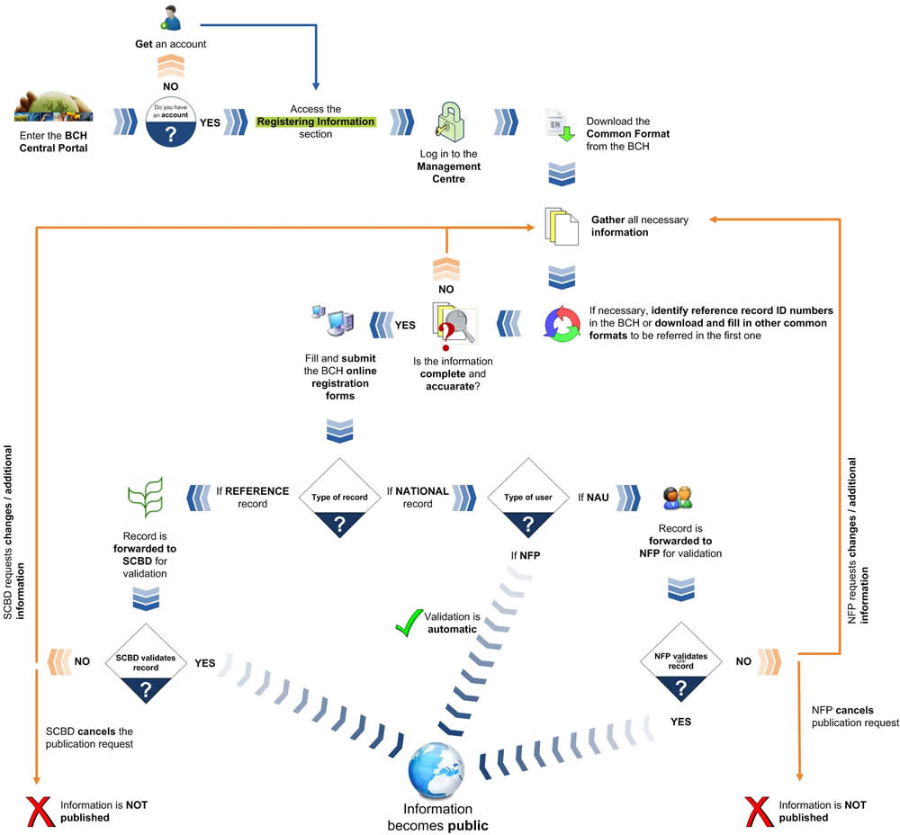

Slide 20
The virtual learning environment
Demonstration on the Virtual Learning Environment
http://vle.bch3-un.org

Slide 21
Relevant available educational resources
- Training manuals:
Training manual no 6, 7 and 8
- Case studies:
Case studies no 4,5,6,14,16,17,18,23,25 and 26
- NEW BCH PLATFORM TRAINING VIDEOS:
https://bch3-vle.unep.org/course/view.php?id=92

